Slide 1
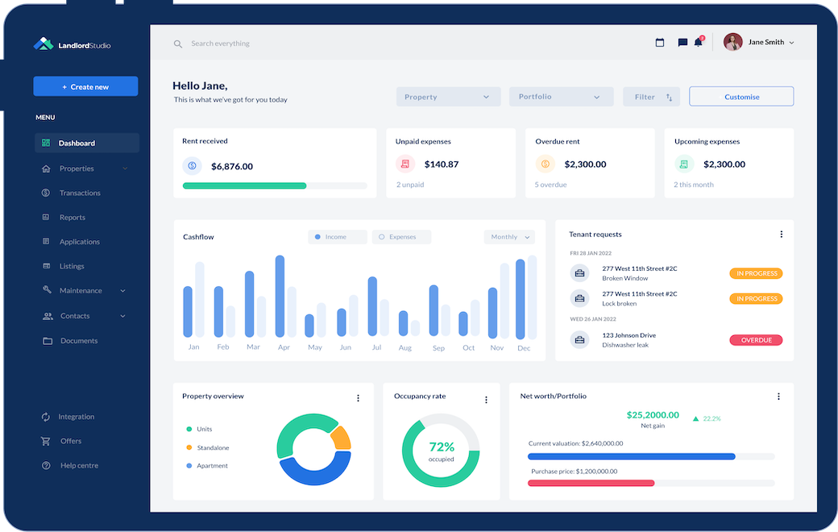

Project Bruin
Investor Presentation
October 2024
Strictly Confidential
Insert
Sponsor Logo
Insert
Company Logo

Slide 2
Disclaimer
Sponsor to insert their off-the-shelf Disclaimer language

Slide 3
Opportunity Overview
[Firm] has signed an LOI to acquire a leading software provider in the property management services space
[Company name] (“Bruin”, or the “Company”) is a leading provider of comprehensive property management software services across the U.S.
The Company provides software services to over 15K properties including 32 of the top 100 largest property managers in the country
[Product offering and differentiation]
[Customer stickiness / loyalty / brand recognition]
Bruin was founded in 2014 and is headquartered in Baltimore, MD
[Sponsor] has signed a letter of intent (“LOI”) to acquire Bruin for an attractive purchase price of $55.0 million representing a 3.1x ARR purchase price
We have 60 days of exclusivity and are raising $22 million of equity to close the transaction on December 31, 2024
Robust Financial Growth
Representative Customers
($ millions)
+31.0% CAGR
Bruin’s top 10 customers represent 33% of 2023A sales
and 29% of LTM Jun-24A sales
Source: Company Information.

Slide 4

Key Investment Highlights
Insert
Company Logo
✓ | [ ]
✓ | [ ]
✓ | [ ]
✓ | [ ]
✓ | [ ]
✓ | [ ]
✓ | [ ]
✓ | [ ]
Source: Company Information.

Slide 5
Transaction Summary
[Sponsor] has [Company] under LOI at a highly attractive purchase price with downside protection
[Discuss headline purchase price based on ARR or Adj. EBITDA]
[Discuss debt used in the transaction including pricing and any key covenants]
[Discuss seller rollover and seller note creating alignment of interest]
[Discuss attachment point based on preferred equity / downside protection]
[Discuss equity raise and capital required to close on the transaction]
Projected Returns
Summary Returns Table
Sources & Uses Summary
Insert S&U Table
Note: Sources & Uses including final allocation, seller note amount, and transaction expenses are estimates and subject to change prior to closing.

Slide 6
Diligence Timeline
[Sponsor] is raising [$X.X] million and looking for preliminary indications of interest on [XXXX]
[Signed LOI and days of exclusivity]
[Timeline to closing]
[Update on third-party workstreams and key areas of diligence]
[Amount looking to be raised and potential reserves for future tuck-ins / follow-ons]
Due Diligence Timeline Summary
Commercial Diligence:
  IOI Submitted: [ ]
  LOI signed: [ ]
  Preliminary Investor Indications: [ ]
  Lender Reads: [ ]
Customer Interviews: [ ]
Financial & Tax Diligence: [ ]
Insurance & HR Diligence: [ ]
Legal & Visa Diligence: [ ]
Financial / QoE
Insurance & Benefits
Logo
Logo
Legal
Client DD
Logo
Logo
Note: diligence timeline is subject to change.

Slide 7
Sponsor Overview
[Sponsor] is led by two highly experienced Partners who are excited to accelerate Bruin’s growth
Picture
Picture
Jack Johnson
Founder & Managing Partner
Jack Johnson
Founder & Managing Partner
[Current experience]
[Relevant deals to Project Bruin]
[Prior experience and roles]
Jack holds a B.S. in Finance from the [XXXX] and an M.B.A. from [XXXX]
[Current experience]
[Relevant deals to Project Bruin]
[Prior experience and roles]
Jack holds a B.S. in Finance from the [XXXX] and an M.B.A. from [XXXX]
Education
Experience
Education
Experience
Logos
Logos
Logos
Logos

Slide 8
Investment Merits
Continue to successfully execute affiliation strategy to build density in existing markets via clusters
[ ]
[ ]
[ ]
Attractive Transaction Structure
[ ]
[ ]
[ ]
Industry
Tailwinds
[ ]
[ ]
[ ]
Company Logo
Unique
Value
Proposition
[ ]
[ ]
[ ]
Software Capabilities
Multi-Pronged Growth
Strategy
[ ]
[ ]
[ ]
Source: Company Information.

Slide 9
Risks & Mitigants
Description
Initial Risk Mitigant(s)
Customer Concentration
[ ]
[ ]
[ ]
[ ]
[ ]
[ ]
Competitive Landscape
[ ]
[ ]
[ ]
[ ]
[ ]
[ ]
Declining Margins
[ ]
[ ]
[ ]
[ ]
[ ]
[ ]
Capital Intensity
[ ]
[ ]
[ ]
[ ]
[ ]
[ ]
Source: Company Information.

Slide 10
Industry Overview
The property management software segment represents a $26 billion market today that has grown slightly faster than GDP at nearly 5% per annum
[Industry overview]
[Key participants]
[Large public players / market leaders]
[Barriers to entry]
[Market segmentation and where Bruin focuses]
Total Addressable Market
Market Segmentation
($ billions)
($ billions)
+4.6% CAGR
Source: Industry Research, Pitchbook, Preqin.

Slide 11
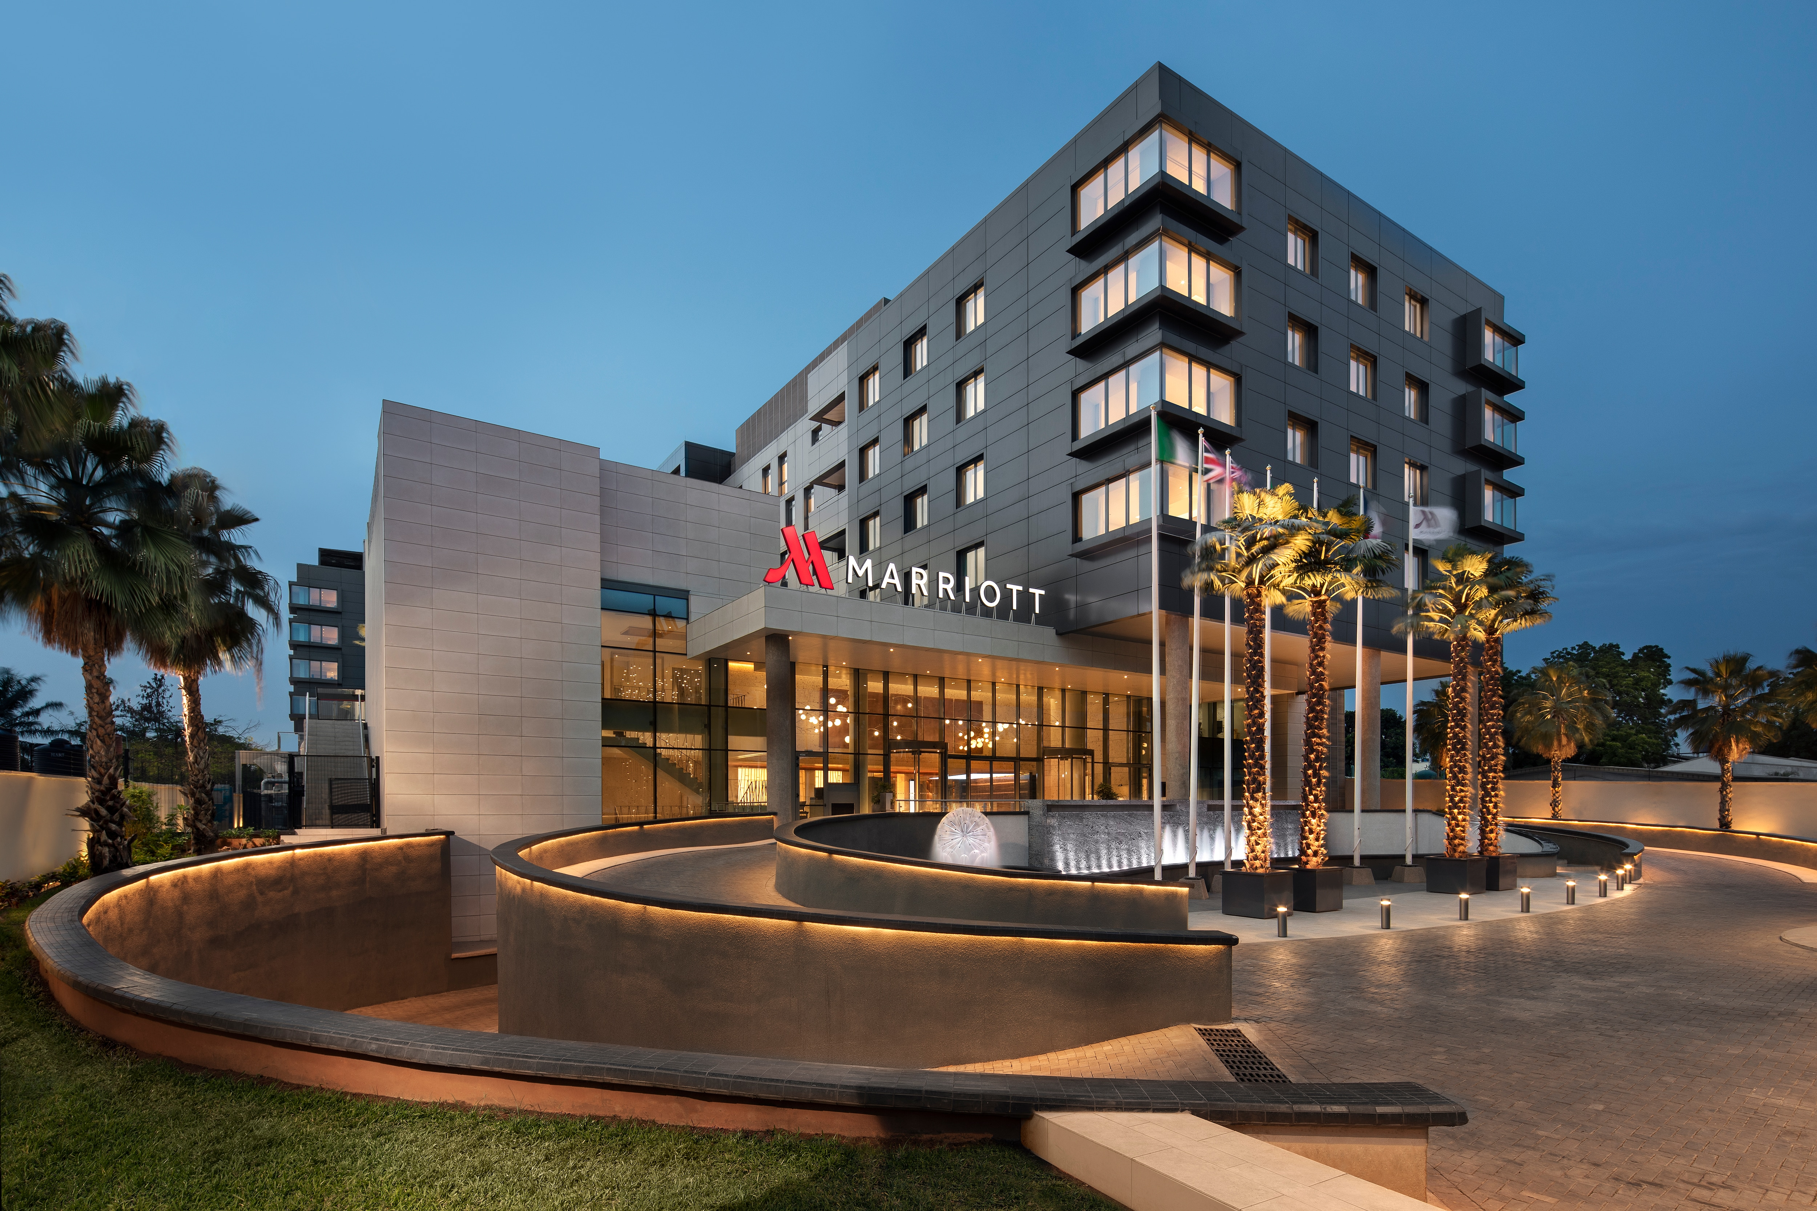



TAM Opportunity by End Market
[Bruin] caters to a diverse set of end markets creating ample opportunity for future new customer wins with its sticky property management software offering
End Market
Description
Gross Margin
Clients
Hotels
(42% of ARR)
[ ]
[ ]
Condominiums
(19% of ARR)
[ ]
[ ]
Multi-Family
(9% of ARR)
[ ]
[ ]
Student Housing
(6% of ARR)
[ ]
[ ]
Source: Company Information.

Slide 12
Competitive Landscape
[Company] maintains the broadest service offering among its key competitors, without sacrificing customer service
[Competitive landscape commentary around service, pricing, market share]
[ ]
Background
Selected Service
Company
Ownership
Headquarters
[ ]
[ ]
[ ]
[ ]
[ ]
[ ]
[ ]
Company Logo
P
P
P
P
P
P
P
Private
XXXX
Competitor Logo
P
P
P
P
P
Public
XXXX
Competitor Logo
P
P
P
P
PE-Backed
XXXX
Competitor Logo
Growth Equity-Backed
P
P
P
XXXX
Competitor Logo
P
Private
XXXX
Source: Industry Research.

Slide 13
Services Overview
Company Logo
[ ]
[ ]
[ ]
[ ]
[ ]
[ ]
[ ]
[ ]
[ ]
[ ]
[ ]
[ ]
[ ]
[ ]
[ ]
[ ]
[ ]
[ ]
[ ]
[ ]
[ ]
[ ]
Service Picture
Service Picture
Service Picture
Service Picture
Source: Company Information.

Slide 14
Unique Value Proposition
[Company] offers a superior value proposition and is positioned as a ‘one-stop shop’ for customers’ property management needs through its proprietary software
Proprietary Software
Sticky Service Offering
Experienced Personnel
[ ]
[ ]
[ ]
[ ]
[ ]
[ ]
[ ]
[ ]
[ ]
[ ]
[ ]
Significant historical recurring top-line growth with defensible market position and expanding margins

Slide 15
Business Mix
[Company] is highly diversified across geography and service offering type
[ ]
[ ]
[ ]
[ ]
Revenue by Service Offering
Revenue by Geography
Source: Company Information.

Slide 16
Customer Summary
[ ]
[ ]
[ ]
[ ]
Top 10 Customers Summary
Growth in Customers >$400K of Annual ARR
Top customer trends
summary table
Source: Company Information.

Slide 17
Customer Retention Analysis
[Company’s] sticky service offering and long-term contracts have led to strong recurring revenue and little client churn
Customer Retention Commentary
Aggregate Customer Retention
[ ]
[ ]
[ ]
[ ]
Client Retention Table
Large Customer Retention
Client Retention Table
Retention Analysis Table
Customers ‘lost’ are not due to poor customer service
but rather the completion of larger projects and customers closing facilities or moving out of a specific service offering
Source: Company Information.

Slide 18
Customer Cohort Analysis
Many of the Company’s customers will continue to utilize the Company’s services beyond the initial year of onboarding with subsequent projects or maintenance services
Cohort Commentary
Customer Cohort Analysis
[ ]
[ ]
[ ]
[ ]
($ 000’s)
Customer Cohort Trends Table
Source: Company Information.

Slide 19
Recent Momentum
[Company] has developed a growing base of monthly active users with increasing ARR per client
[Growth in customer base]
[Recent new customer wins]
[Customer concentration being diversified]
[Monetizing existing customer base]
Monthly Active Users and ARR per Customer
Bar Chart with Active Monthly Users and Line Chart for ARR per customer
Source: Company Information.

Slide 20
Free Trial Conversions
[Company] has leveraged free trials as a foot-in-the-door methodology to drive stickiness with its core software offering, driving strong conversion rates to full-time new clients
Number of New Trials Started by Month
[ ]
[ ]
[ ]
[ ]
Line chart of monthly new trials started
Free Trial Conversion Rate
Line chart showing trend in conversion rates
Source: Company Information.

Slide 21
Near-Term Customer Pipeline
[Company] has built up a strong near-term pipeline of blue-chip customers and new opportunities that should drive incremental growth into 2025
[ ]
[ ]
[ ]
[ ]
Near-Term Customer Pipeline
Blinded table of near-term customers to pursue
Source: Company Information.

Slide 22
Current Management Team
[Company’s] management team is highly experienced across the environmental services and remediation space
Picture
[ ]
[ ]
[ ]
[ ]
Jack Johnson
CEO
Picture
[ ]
[ ]
[ ]
[ ]
Jack Johnson
CFO
Picture
[ ]
[ ]
[ ]
[ ]
Jack Johnson
COO
Source: Company Information.

Slide 23
Management Organizational Chart
[Company] has developed a highly motivated and experienced management team who is capable in accelerating the Company’s growth over the next five years
Jack Johnson
CEO
Jack Johnson*
Chairman
Jack Johnson
CTO
Jack Johnson
COO
Jack Johnson
CFO
Jack Johnson
Software Engineer
Jack Johnson
IT Manager
Jack Johnson
VP of HR
Jack Johnson
Project Manager
Jack Johnson
Controller
Jack Johnson
Software Developer (5)
Jack Johnson
Accountant
* Denotes management members who will not be transitioning with the Company
Source: Company Information.

Slide 24
Historical Financial Summary
[ ]
Historical P&L table showing revenue, gross profit, EBITDA and EBITDA adjustments as well as customer growth and ARR growth
Source: Company Information.

Slide 25
Quarterly Ramp
[Company] continues to rapidly grow generating record quarterly ARR and gross profit and the end of 2023 while maintaining steady gross profit margins in early 2024
Historical Quarterly ARR
($ 000’s)
Historical Quarterly
Gross Profit
($ 000’s)
Source: Company Information.

Slide 26
Revenue by Service Offering
[Company] has steadily grown each of its core service offerings since 2020
Service 1 Revenue
Service 2 Revenue
($ 000’s)
($ 000’s)
+32% CAGR
+38% CAGR
Service 3 Revenue
Service 4 Revenue
($ 000’s)
($ 000’s)
+31% CAGR
+23% CAGR
Source: Company Information.

Slide 27
Balance Sheet Summary
[Company] has developed a healthy balance sheet in recent years with growing equity value
Source: Company Information.

Slide 28
Growth Plan
[Company] has displayed strong historical organic growth and management has positioned the business well to accelerate growth over the next five years
Enhanced Software Capabilities
Refined Go-To-Market Strategy
Pursue M&A
[Buildout of new tech-enabled capabilities]
[Cater to specific high-profile customers that require new features]
[Attractive ROI to build in-house vs. acquire]
Increased Marketing
Efforts
[Business development]
[Recurring contracts and pricing power]
[Bolstered ARR]
[Accretive tuck-ins]
[Buy into new services]
[Acquire customers and create cross-sell]
[improved visibility and brand presence]
[Hone in on specific client types]
[Customer acquisition cost / more effective marketing]
Source: Company Information.

Slide 29
Sponsor Returns Summary
[Company] represents an attractive opportunity to invest into a leading software provider with high-growth potential and strong downside protection
Returns Commentary
Returns Summary
[ ]
[ ]
[ ]
[ ]
Table showing base case, upside case, downside case returns
Source: Company Information.

Slide 30
Base Case Forecast
[ ]
Returns Commentary
[ ]
[ ]
[ ]
[ ]
Financial Projections P&L Table
Source: Company Information.

Slide 31
Upside Case Forecast
[ ]
Returns Commentary
[ ]
[ ]
[ ]
[ ]
Financial Projections P&L Table
Source: Company Information.

Slide 32
Downside Case Forecast
[ ]
Returns Commentary
[ ]
[ ]
[ ]
[ ]
Financial Projections P&L Table
Source: Company Information.

Slide 33
Precedent Transactions
The acquisition of [Company] is a material discount to the recent precedent transactions in the property management services software space
($ millions)
Investment
Date
LTM
Valuation
Company
Investor
ARR
EBITDA
ARR
EBITDA
Logos
Logos
Oct-18
$8.5
$1.5
5.0x
13.5x
Source: Industry Research.

Slide 34
Clear Exit Opportunities
[Company] should generate significant interest from both strategic acquirors and financial sponsors at exit
Company Logo
Strategic Acquirors
Financial Sponsors
Buyer Logos
Buyer Logos
Buyer Logos
Buyer Logos
Buyer Logos
Buyer Logos
Buyer Logos
Buyer Logos
Buyer Logos
Buyer Logos
Buyer Logos
Buyer Logos
Source: Company Information.

Slide 35
Conclusion
[Sponsor] believes [Company] represents an attractive opportunity to acquire a market leader with strong recurring revenue and the potential for market share gains leading to margin improvement over time
P
High-Growth Business Operating in an Attractive Geography & End Market
[ ]
P
Industry-Leading Software with Extensive Capabilities to Drive Recurring Growth
[ ]
P
Institutional, Experienced Management Team Looking for Partner to Scale
[ ]
Source: Company Information.

Slide 36
Thank You

