Slide 1
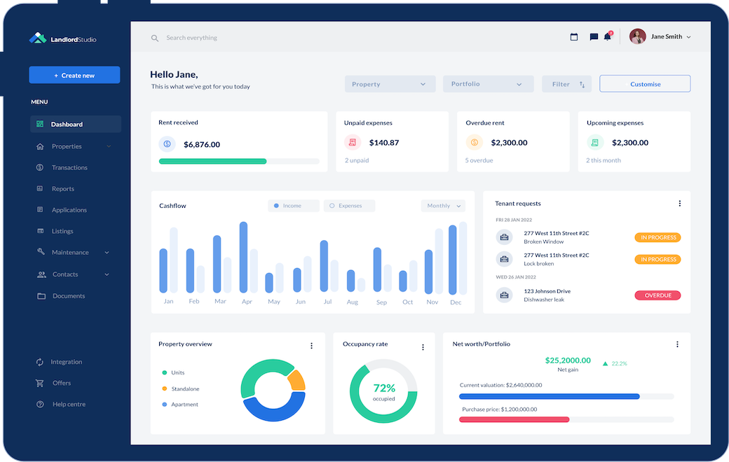

Project Bruin
Confidential Information Memorandum
October 2024
Strictly Confidential
Insert
Sponsor Logo
Insert
Company Logo

Slide 2
Disclaimer
Sponsor to insert their off-the-shelf Disclaimer language

Slide 3
Opportunity Overview
[Firm] has signed an LOI to acquire a leading software provider in the property management services space
[Company name] (“Bruin”, or the “Company”) is a leading provider of comprehensive property management software services across the U.S.
The Company provides software services to over 15K properties including 32 of the top 100 largest property managers in the country
[Product offering and differentiation]
[Customer stickiness / loyalty / brand recognition]
Bruin was founded in 2014 and is headquartered in Baltimore, MD
[Sponsor] has signed a letter of intent (“LOI”) to acquire Bruin for an attractive purchase price of $55.0 million representing a 3.1x ARR purchase price
We have 60 days of exclusivity and are raising $22 million of equity to close the transaction on December 31, 2024
Robust Financial Growth
Representative Customers
($ millions)
+31.0% CAGR
Bruin’s top 10 customers represent 33% of 2023A sales
and 29% of LTM Jun-24A sales
Source: Company Information.

Slide 4
Company History
[Company] has a long-standing history of growth and market share gains built upon its strong reputation in the marketplace
[ ]
[ ]
[ ]
[ ]
[ ]
Company Timeline
1999-2005
2006-2010
2011-2015
2016-2020
2021-Present
1999
Company Founded
2003
Acquired by Odyssey
2007
Acquired by DLJ Merchant Banking
2010
Acquired out of bankruptcy
2014
Acquired by Calera
2017
Acquired by Platinum
2021
Platinum raises CV
Source: Company Information.

Slide 5
Investment Merits
Continue to successfully execute affiliation strategy to build density in existing markets via clusters
[ ]
[ ]
[ ]
Attractive Transaction Structure
[ ]
[ ]
[ ]
Industry
Tailwinds
[ ]
[ ]
[ ]
Company Logo
Unique
Value
Proposition
[ ]
[ ]
[ ]
Software Capabilities
Multi-Pronged Growth
Strategy
[ ]
[ ]
[ ]
Source: Company Information.

Slide 6
Industry Overview
The property management software segment represents a $26 billion market today that has grown slightly faster than GDP at nearly 5% per annum
[Industry overview]
[Key participants]
[Large public players / market leaders]
[Barriers to entry]
[Market segmentation and where Bruin focuses]
Total Addressable Market
Market Segmentation
($ billions)
($ billions)
+4.6% CAGR
Source: Industry Research, Pitchbook, Preqin.

Slide 7
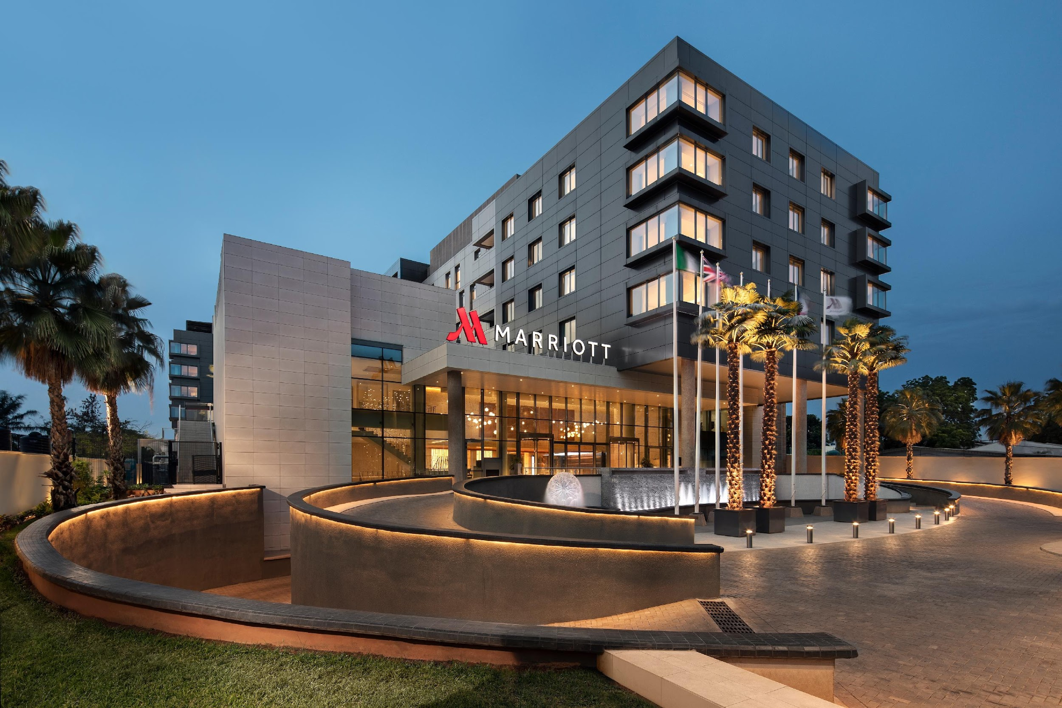



TAM Opportunity by End Market
[Bruin] caters to a diverse set of end markets creating ample opportunity for future new customer wins with its sticky property management software offering
End Market
Description
Gross Margin
Clients
Hotels
(42% of ARR)
[ ]
[ ]
Condominiums
(19% of ARR)
[ ]
[ ]
Multi-Family
(9% of ARR)
[ ]
[ ]
Student Housing
(6% of ARR)
[ ]
[ ]
Source: Company Information.

Slide 8
Industry Tailwinds
The demand for software services within the property management segment and need for automation provides strong long-term tailwinds to [Company]
Increased Spend on Automation
Movement Towards Outsourcing
Highly Fragmented
Patient Centric Care
  [ ]
  [ ]
  [ ]
  [ ]
  [ ]
  [ ]
  [ ]
  [ ]
  [ ]
Source: Industry Research.

Slide 9
Competitive Landscape
[Company] maintains the broadest service offering among its key competitors, without sacrificing customer service
[Competitive landscape commentary around service, pricing, market share]
[ ]
Background
Selected Service
Company
Ownership
Headquarters
[ ]
[ ]
[ ]
[ ]
[ ]
[ ]
[ ]
Company Logo
✓
✓
✓
✓
✓
✓
✓
Private
XXXX
Competitor Logo
✓
✓
✓
✓
✓
Public
XXXX
Competitor Logo
✓
✓
✓
✓
PE-Backed
XXXX
Competitor Logo
Growth Equity-Backed
✓
✓
✓
XXXX
Competitor Logo
✓
Private
XXXX
Source: Industry Research.

Slide 10
Services Overview
Company Logo
[ ]
[ ]
[ ]
[ ]
[ ]
[ ]
[ ]
[ ]
[ ]
[ ]
[ ]
[ ]
[ ]
[ ]
[ ]
[ ]
[ ]
[ ]
[ ]
[ ]
[ ]
[ ]
Service Picture
Service Picture
Service Picture
Service Picture
Source: Company Information.

Slide 11
Software Capabilities
The Company has developed a truly differentiated software solution that has disrupted the property management services market
Software Capabilities
[ ]
[ ]
[ ]
[ ]
[ ]
✔
        [ ]
✔
        [ ]
✔
        [ ]
✔
        [ ]
Software Buildout Timeline
2021
Software development takes place
2022
Initial beta testing with select customers
2023
Initial system goes live for clients
Apr-24
Company achieves 50K+ recurring users
Source: Company Information.

Slide 12
Unique Value Proposition
[Company] offers a superior value proposition and is positioned as a ‘one-stop shop’ for customers’ property management needs through its proprietary software
Proprietary Software
Sticky Service Offering
Experienced Personnel
[ ]
[ ]
[ ]
[ ]
[ ]
[ ]
[ ]
[ ]
[ ]
[ ]
[ ]
Significant historical recurring top-line growth with defensible market position and expanding margins

Slide 13
Business Mix
[Company] is highly diversified across geography and service offering type
[ ]
[ ]
[ ]
[ ]
Revenue by Service Offering
Revenue by Geography
Source: Company Information.

Slide 14
Customer Summary
[ ]
[ ]
[ ]
[ ]
Illustrative customer logos
Top 10 Customers Summary
Growth in Customers >$400K of Annual ARR
Top customer trends
summary table
Source: Company Information.

Slide 15
Customer Case Study
[ ]
[Discuss customer relationship and onboarding process / how the business was won]
[Discuss pricing model of the client and services being utilized]
[Discuss growth with the client and how the relationship has developed / progressed over time]
[Discuss proactive account management and business development opportunities]
Near-Term Client Projects
Ramping ARR
[Highlight current projects under contract]
[Discuss near-term opportunities and growth areas to expand relationship with the client]
[Breakout of volume vs. pricing growth over time]
Bar Chart showing Growth in ARR since inception (include projections for 2025-2026)
Source: Company Information.

Slide 16
Customer Testimonials
[ ]
Customer
Services Utilized
Client Testimonial
Logo
[ ]
[ ]
[ ]
Quote from customer on strength in relationship
Logo
[ ]
[ ]
[ ]
Quote from customer on strength in relationship
Logo
[ ]
[ ]
[ ]
Quote from customer on strength in relationship
Logo
[ ]
[ ]
[ ]
Quote from customer on strength in relationship
Source: Company Information.

Slide 17
Customer Retention Analysis
[Company’s] sticky service offering and long-term contracts have led to strong recurring revenue and little client churn
Customer Retention Commentary
Aggregate Customer Retention
[ ]
[ ]
[ ]
[ ]
Client Retention Table
Large Customer Retention
Client Retention Table
Retention Analysis Table
Customers ‘lost’ are not due to poor customer service
but rather the completion of larger projects and customers closing facilities or moving out of a specific service offering
Source: Company Information.

Slide 18
Customer Cohort Analysis
Many of the Company’s customers will continue to utilize the Company’s services beyond the initial year of onboarding with subsequent projects or maintenance services
Cohort Commentary
Customer Cohort Analysis
[ ]
[ ]
[ ]
[ ]
($ 000’s)
Customer Cohort Trends Table
Source: Company Information.

Slide 19
Near-Term Customer Pipeline
[Company] has built up a strong near-term pipeline of blue-chip customers and new opportunities that should drive incremental growth into 2025
[ ]
[ ]
[ ]
[ ]
Near-Term Customer Pipeline
Blinded table of near-term customers to pursue
Source: Company Information.

Slide 20
Infrastructure & Systems
[Company] has invested into strong systems and infrastructure to support near-term growth
Tech Stack / Software
[ ]
[ ]
[ ]
[ ]
Logo
Employee Payroll
[ ]
[ ]
[ ]
[ ]
Logo
Finance & Accounting
[ ]
[ ]
[ ]
[ ]
Logo
Source: Company Information.

Slide 21
Highly Experienced Management Team…
[Company’s] management team is highly experienced across the environmental services and remediation space
Picture
[ ]
[ ]
[ ]
[ ]
Jack Johnson
CEO
Picture
[ ]
[ ]
[ ]
[ ]
Jack Johnson
CFO
Picture
[ ]
[ ]
[ ]
[ ]
Jack Johnson
COO
Source: Company Information.

Slide 22
…Supported by Strong Second Tier of Management
The Company’s mid-level operations team provides a strong support system to the C-suite
Picture
[ ]
[ ]
[ ]
[ ]
Jack Johnson
VP of Operations
Picture
[ ]
[ ]
[ ]
[ ]
Jack Johnson
Head of HR
Picture
[ ]
[ ]
[ ]
[ ]
Jack Johnson
Regional Manager
Source: Company Information.

Slide 23
Employee Roster
[ ]
Employee Commentary
Employee Roster
[ ]
[ ]
[ ]
[ ]
Table showing employee roster and breakdown of W-2 vs. 1099 employees as well as offshore labor
Source: Company Information.

Slide 24
Management Organizational Chart
[Company] has developed a highly motivated and experienced management team who is capable in accelerating the Company’s growth over the next five years
Jack Johnson
CEO
Jack Johnson*
Chairman
Jack Johnson
CTO
Jack Johnson
COO
Jack Johnson
CFO
Jack Johnson
Software Engineer
Jack Johnson
IT Manager
Jack Johnson
VP of HR
Jack Johnson
Project Manager
Jack Johnson
Controller
Jack Johnson
Software Developer (5)
Jack Johnson
Accountant
* Denotes management members who will not be transitioning with the Company
Source: Company Information.

Slide 25
Sales & Marketing
The Company’s sales & marketing efforts are led by [XXXX] along with a team of seasoned project managers and sales reps to drive sticky customer relationships through a well-designed go-to-market strategy
Go-To-Market Strategy
[ ]
[ ]
[ ]
[ ]
[ ]
Jack Johnson
Head of Sales
Reputation
[ ]
(2) Senior Project Managers
(3) Sales Reps
Social Media
Tradeshows
Company Logo
Key Sales & Marketing Objectives
[ ]
[ ]
[ ]
[ ]
[ ]
[ ]
Conferences
Customer Service
[ ]
Source: Company Information.

Slide 26
Historical Financial Summary
[ ]
Historical P&L table showing revenue, gross profit, EBITDA and EBITDA adjustments as well as customer growth and ARR growth
Source: Company Information.

Slide 27
Quarterly Ramp
[Company] continues to rapidly grow generating record quarterly ARR and gross profit and the end of 2023 while maintaining steady gross profit margins in early 2024
Historical Quarterly ARR
($ 000’s)
Historical Quarterly
Gross Profit
($ 000’s)
Source: Company Information.

Slide 28
Revenue by Service Offering
[Company] has steadily grown each of its core service offerings since 2020
Service 1 Revenue
Service 2 Revenue
($ 000’s)
($ 000’s)
+32% CAGR
+38% CAGR
Service 3 Revenue
Service 4 Revenue
($ 000’s)
($ 000’s)
+31% CAGR
+23% CAGR
Source: Company Information.

Slide 29
Balance Sheet Summary
[Company] has developed a healthy balance sheet in recent years with growing equity value
Balance sheet summary for past 3 years
Source: Company Information.

Slide 30
Net Working Capital Schedule
[ ]
Show attractive net working capital dynamics
Source: Company Information.

Slide 31
Historical Capital Expenditures
[ ]
[ ]
[ ]
[ ]
[ ]
Capital expenditure trends breaking out growth vs. maintenance capex and highlighting any recent one-time investments into software / growth
Source: Company Information.

Slide 32
Thank You

